Slide 1
Welcome to CS622!
Greetings.

Slide 2

About the Course
Notes:
Applications are our interface to the digital world, and have in many ways become integral to most peoples’ lives.
Applications are programmed, and it takes great skill and care to create robust and useful applications.
In this course, we teach you many advanced skills and concepts you need to do so.

Slide 3
About Me
Instructor and Course Developer
Husband and Father
Professional

Slide 4
Course Focus and Language
The focus of this course is learning critical programming concepts that will last you decades.
Nevertheless, we must work with a language for practice and learning, and that language is Java.
If you’d like to use another language, please reach out to your facilitator.

Slide 5
Course Structure
Your Group
Teaching Team
Ask the Teaching Team Forum
Notes:
You are part of a group of roughly 15 students, with your own group facilitator, who is your primary point of contact.
The Ask the Teaching Team forum is the best place to ask questions pertinent to the class.

Slide 6
Helpful Resources
Online Lectures
Textbook Readings
Live Sessions
Ask the Teaching Team Forum
Notes:
We will cover relevant topics from the week we are in, with a focus on what you need to complete your assignments and answer the quiz questions.
Slide presentations and occasionally screen sharing will be utilized.
Some examples include:
Explaining key concepts
Laying a Framework
Learning By Example
Adding Industry Experience to Theory
Many report that the supplemental live sessions help them succeed.
Each review question covers a subject area. f you are unable to successfully answer a review question, it is best to study that subject area in the lecture and textbook until you can answer not only that question, but other questions concerning the same subject matter. Those who do so have an advantage over those who only study the review questions themselves.

Slide 7
Course Gradable Items
Term Project 60%
Final Exam 30%
Interim Assessments 10%

Slide 8
Recommended Sequence
Textbook Readings
Lecture Readings
Interim Assessment
Term Project Assignment

Slide 9
Getting Help
Programming is broad, deep, and highly technical. The entire teaching team is here to help with any questions you may have! Make heavy use of the Ask the Facilitators forum and Live Classroom sessions for any questions.

Slide 10
Researching
Make heavy use of course resources including online lectures, the textbook, live sessions, and instructor/facilitator communications.
Fill in any extra details with external sources (if needed).

Slide 11
Completing Your Own Work
It is crucial you complete your own work.
Putting in serious effort now and learning is the right thing to do.
At job interviews, employers are asking students to demonstrate their knowledge in a live manner, such as live class design and coding.
You need to be able to do the job your degree claims you can do.

Slide 12
Interacting with your Facilitator
Your facilitator is here to help you.
We carefully vet facilitators based upon their academic and industry experience, as well as their ability to positively interact with others (peers and course takers).
Many facilitators have years of experience with the course.
If despite our best efforts you have issues interacting with your facilitator, please reach out to me.

Slide 13
Submission Review
Facilitators carefully review each submission.
Due to their experience, facilitators will see areas needing improvement as well as excellent areas and comment on both.
Facilitators are kind and respectful.

Slide 14
Grading Rubrics
Your facilitator uses a grading rubric in combination with course and field experience to assign submissions a fair, objective grade.
Every submission is evaluated with the same measuring stick.
The rubric defines the “buckets”.
Each “bucket” carries a grade value.

Slide 15
Term Project Rubric
Criterion | D | C | B | A
Technical Correctness | No justification of correctness | Technically mostly correct; tested | Implementation correctness well justified; commented completely; well commented and tested | Implementation correctness thoroughly justified throughout by precise block and line comments and tests.
Clarity in Presentation | Unclear | Somewhat clear | Clear with a few exceptions. | Entirely clear throughout
Depth and Thoroughness of Coverage | Shallow or superficial coverage of most topics | Satisfactory depth and thoroughness | Evidence of depth and thoroughness in covering most topics | Evidence of depth and thoroughness in covering all topics

Slide 16
Letter and Number Grades
Grade | Number | Meaning
A | >= 93 | Excellent
A- | >= 90
B+ | >= 87
B | >= 83 | Good
B- | >= 80
C+ | >= 77
C | >= 73 | Fair/Satisfactory
C- | >= 70 | Failure
D | >= 60
F | 0
This is the grade for excelling
This is the grade for doing well
This is the grade for doing fair

Slide 17
Weekly Grading Process
Facilitators are happy to dialog about and clarify their comments in submissions; feel to reach out (it’s a great way to learn).
Side note: Facilitators in every group must use the same grading process for fairness, so cannot negotiate grades individually (notify me if something is really off, of course).

Slide 18
Overall Course Grade
The weighted average as described in the syllabus is the determinant of your overall course grade.
The grading system accepted by universities and Boston University measures mastery of material.
The grading system admittedly only measures that one aspect and is one-dimensional.

Slide 19
Course Schedule
We follow a weekly schedule where every item for a week is due Wednesdays at 6AM.
If something unavoidable comes up and you cannot complete an item by its deadline, please reach out ahead of time and provide the particulars.
We endeavor to be equitable to everyone as each of you sacrifices much in this course schedule; recurring or unexcused lateness carries a 5-point per-day penalty.

Slide 20
Life Impacting Events
It is my wish that you and your family have great health and a positive life situation throughout the term.
If a life impacting event happens during the term (birth of a baby, car accident, death in the family, loss of a job, natural disaster, etc …), please reach out.
I and the teaching team will do everything we can to accommodate your situation.

Slide 21
Why Programming?

Slide 22
What is Programming?
Programming is the art and the science of writing instructions for computers and devices to execute.
You provide a set of instructions in a strictly defined language; these instructions are translated into machine code that the computer can understand.
Learning to program simple tasks is fairly easy; mastering programming requires many skills, a good amount of experience, and a lot of understanding.

Slide 23
More About Computer Languages
A computer language has very strictly defined syntax, structure, sequencing, and many libraries that you must learn to be effective.
There are many kinds of languages. Your current experience as a programmer will likely be with these types:
Imperative languages - describe how a program operates step-by-step with if conditionals, loops, variables, and the like.
Declarative languages - describe the logic without describing its control flow, that is, how the program will accomplish the logic.
Procedural languages – steps of logic are contained within procedures that can be invoked as needed.
Interpreted languages - executes instructions directly without previously compiling the instructions into machine-language instructions.
Scripting languages – executes instructions in the context of a special run-time environment, usually providing higher level commands.

Slide 24
Popularity of Languages
Java and Python are roughly tied as the most popular, most used languages in the world.
Other conventional popular languages include C#, VB.NET, and C++.
JavaScript is by far the most popular web language, with PHP also popular.
C is still widely used, especially for low-level development for the Internet of Things devices.

Slide 25

Language Religion

Slide 26

Language Wars
Notes:
Learn the programming techniques that are language agnostic.
Languages will come and go.
Use the best language for the job, not one language for everything.

Slide 27
The Need for Applications
An application is a piece of software on a computer or device that allows you to perform a specific set of tasks.
Applications have an interface which supports your interaction, logic which makes the tasks work, and storage which stores important durable information for the long-term.
As a programmer, you are typically coding an application.

Slide 28
Application Tiers
Modern applications are becoming increasingly complex, and may require multiple user interfaces.
Modern applications have tiers, where each tier is specifically responsible for a portion of the overall application.
2-tier and n-tier client-server architectures are common.

Slide 29
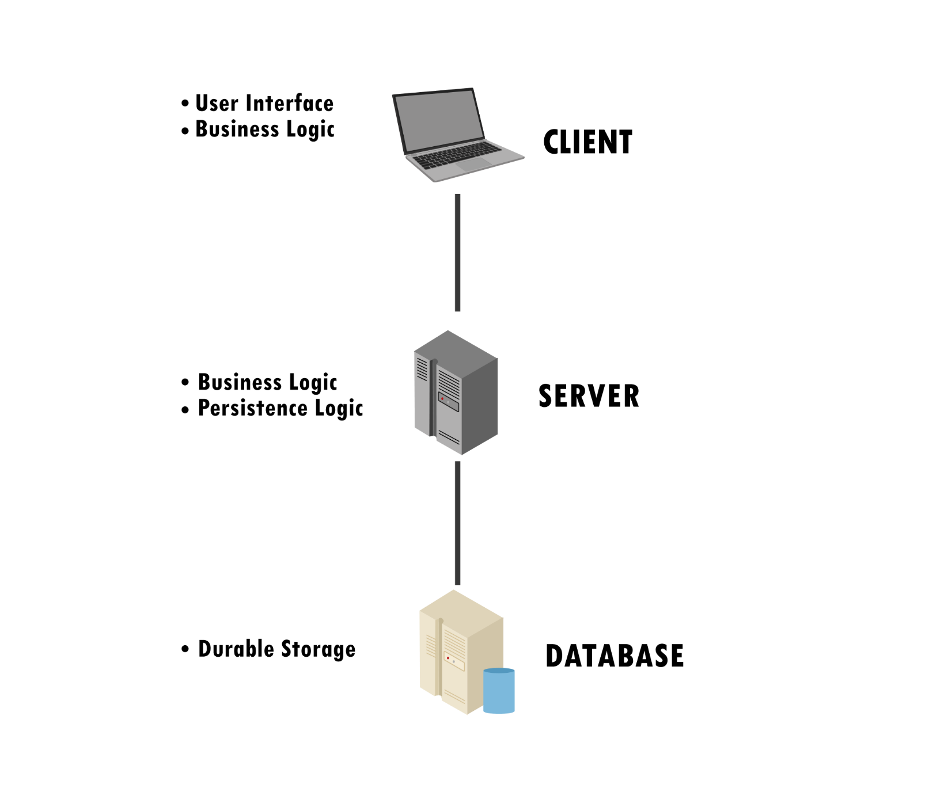
2-tier Client-Server Architecture

Slide 30
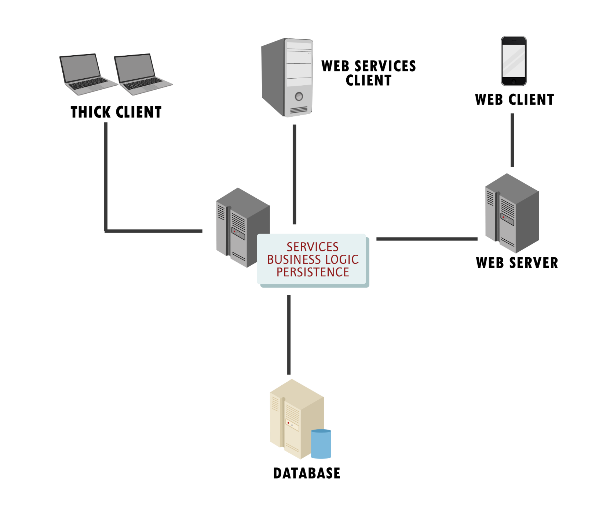
N-Tier Client-Server Architecture

Slide 31
Information Systems
Today, many applications are one component in larger information systems.
With an information system, people, data, processes, and information technology interact to collect, process, and store the information needed to support an organization. (Whitten, 2007)

Slide 32
Information System Examples
Transaction Processing Systems process information about specific business operations.
Management Information Systems report generalized results of business operations.
Communications and Collaboration Systems support communication between users.
Office Automation Systems replace human actions and help improve workflow.
Social Networking & Media Services help people connect and share interests, opinions and ideas through various mediums.

Slide 33
Key Takeaway
Key Takeaway: applications and information systems automate business processes.
Programmers are giving the instructions needed to make this happen.
This takes highly technical knowledge, combined with business knowledge, to do it well.

Slide 34

End

